Slide 1
Title: Portfolio Optimization, Risk Analysis and Backtesting
Presenter: SUN Yuan

Slide 2
Table of contents
01
Part 1: Portfolio Risk Analysis (Latest Long-Term Portfolio)
02
Part 2: Portfolio Construction Backtesting
03
Part 3: Summary and Recommendations

Slide 3
Portfolio Risk Analysis (Latest Long-Term Portfolio)
01

Slide 4
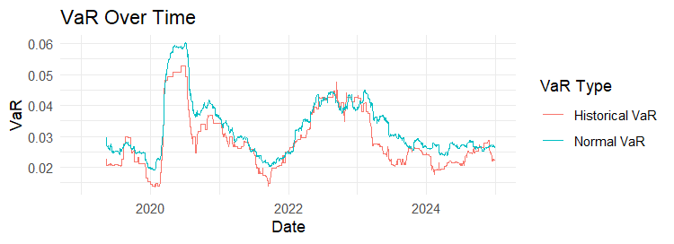
VaR Analysis (Historical vs. Normal Model)
Historical VaR: Captures tail risk using empirical quantiles.
Normal VaR: Underestimates tail risk due to Gaussian assumptions
Historical VaR: 0.02857664
Normal VaR: 0.0304454

Slide 5
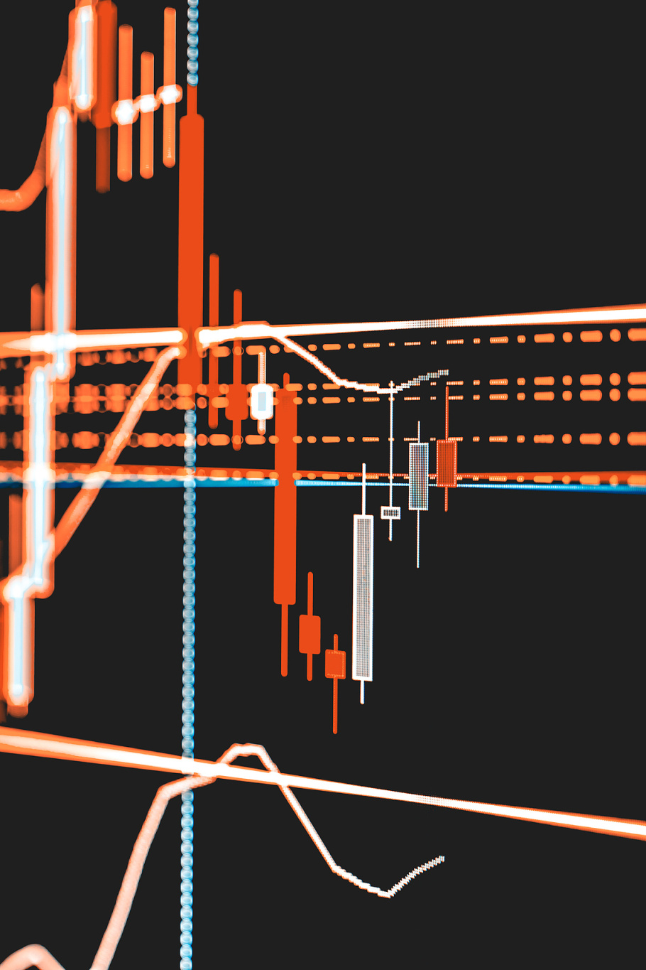
Factor Model and Risk Forecasting
Factor Choice and Risk
12-month momentum （linear regression)
Total Risk:0.01787764
Tracking Error: 0.001474866(benchmark is portfolio return)
Systematic Risk: 0.004398785 (momentum driven)
Idiosyncratic Risk: 0.0178167
AMZN: 9.008023x10⁻⁸
AAPL: 0.01512609
MSFT: 0.86779
GOOG: 0.1170838
Asset contribution of risk

Slide 6
Part 2: Portfolio Construction Backtesting
02

Slide 7
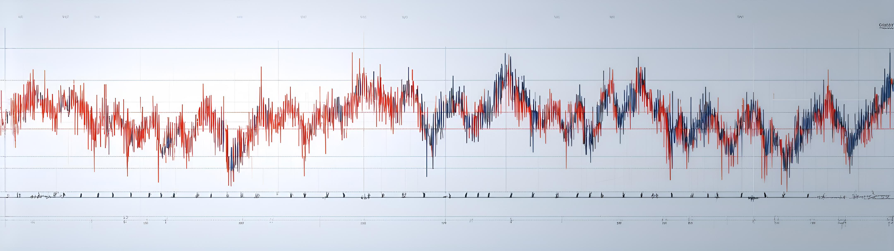
Backtest Strategy Design
Strategies:
Original Equal-Weight (Baseline).
Minimum Tracking Error (Min TE).
Mean-Variance Optimization (MVO).
Rebalancing: Monthly.
Period: 2019–2024.
Original Equal-Weight as benchmark

Slide 8
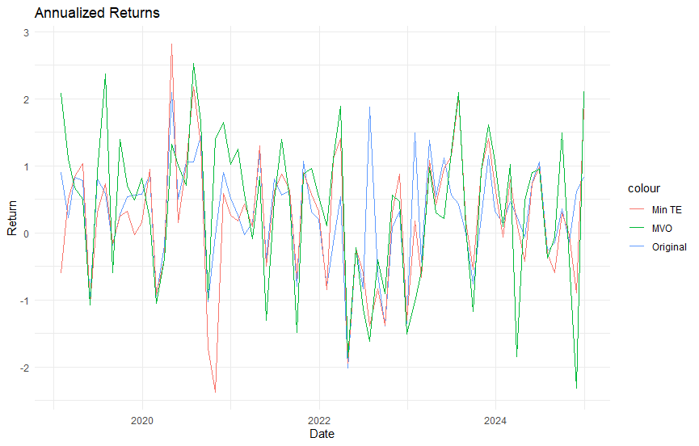
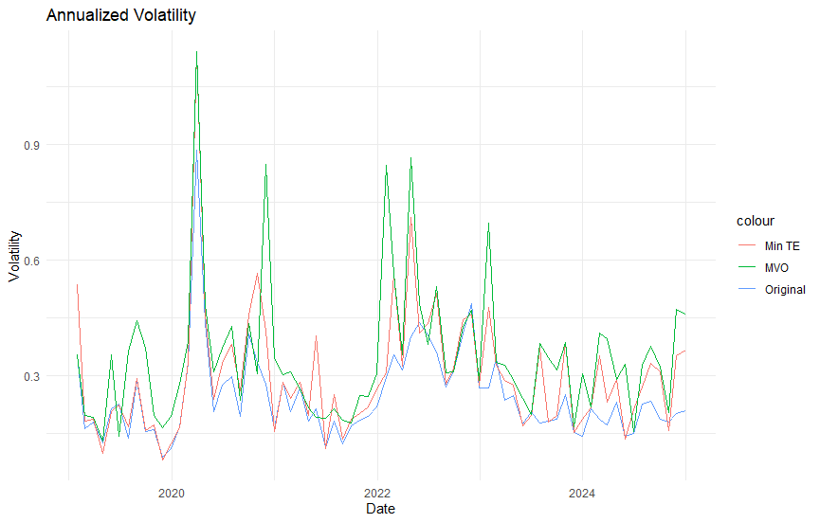
Historical Performance Comparison
Original: 0.283
Min TE: 0.228
MVO: 0.377
Original: 0.247
Min TE: 0.300
MVO: 0.352

Slide 9
Historical Performance Comparison
Min TE return the lowest:
Core Idea of the Min TE Strategy: The primary goal of this strategy is to minimize tracking error rather than maximize returns. This often means that the strategy may be more conservative and not pursue aggressive investments, leading to lower returns.
Market Conditions: If the market is experiencing strong upward movement during the optimization period, the Min TE strategy may capture fewer returns due to its conservative nature, resulting in a lower annualized return.
Volatility of the optimized models higher than that of the unoptimized portfolio:
Design of the Optimization Method: Some optimization methods, such as Min TE or MVO, may attempt to adjust the portfolio weights to reduce error while potentially increasing risk. If the optimization process becomes too concentrated on certain assets, it might lead to increased return volatility.
Market Environment: If the optimized strategy is biased toward high-volatility assets, and those assets perform strongly during the reporting period, the volatility of returns could significantly increase.

Slide 10
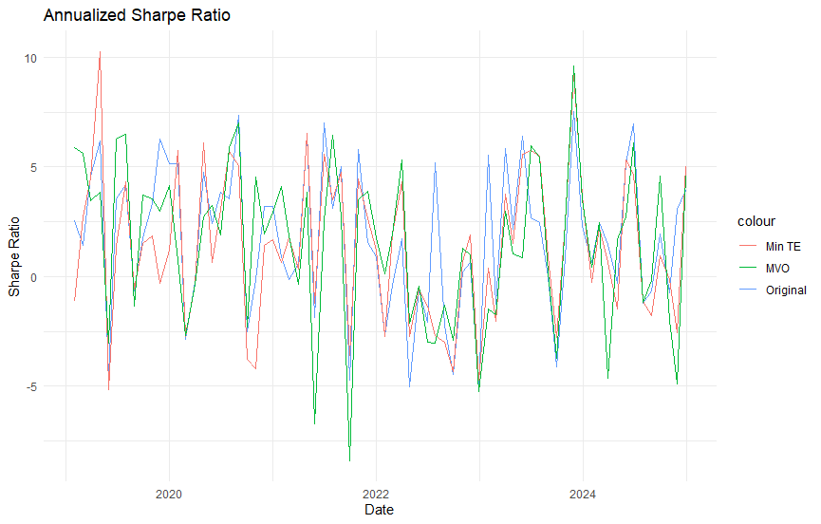
Risk-Adjusted Returns (Sharpe Ratio)
Original: 1.733
Min TE: 1.358
MVO: 1.513
Sharpe ratio of the MVO optimization lower than that of the original portfolio:
Risk-Adjusted Returns: The Sharpe ratio measures excess return per unit of risk. Even if the MVO strategy achieves absolute returns, an increase in volatility may not allow the excess return to improve significantly, resulting in a lower Sharpe ratio.
Asset Allocation in the Portfolio: The MVO process could lead to a greater concentration in high-volatility assets, leading to an overall increase in risk while the returns might not sustain previous levels.

Slide 11
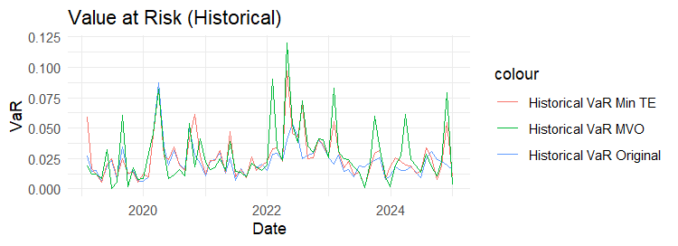
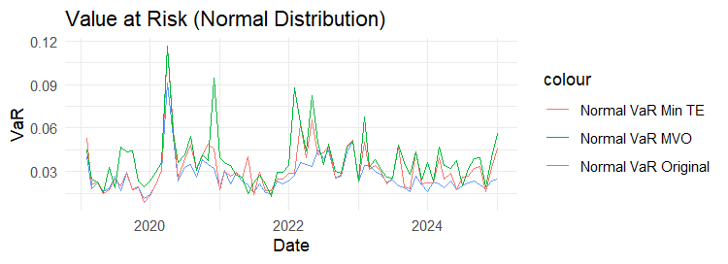
Value at Risk (Historical and Normal Dis.)
Original: 0.0227
Min TE: 0.0263
MVO: 0.0282
Original: 0.0267
Min TE: 0.0320
MVO: 0.0380

Slide 12
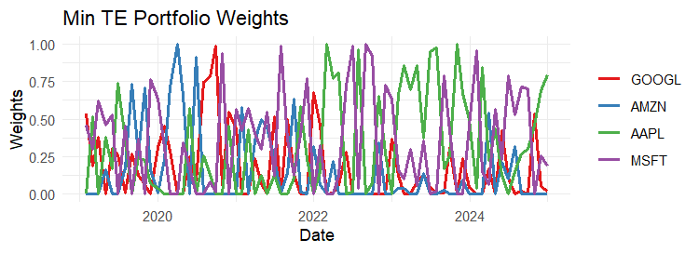
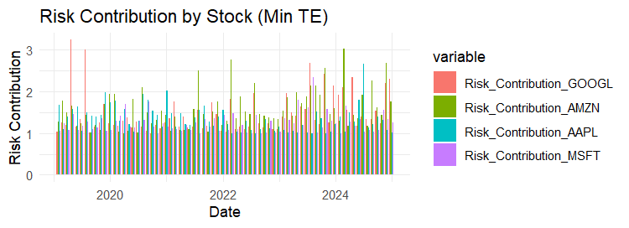
Min TE Performance
The core goal of Min TE optimization is to bring the portfolio closer to the benchmark, not necessarily focusing on the overall risk level. Even if the benchmark itself has low volatility, the asset mix selected during the optimization process may lead to an increase in overall risk.
During the Min TE optimization process, certain assets with higher volatility may be introduced to better track the benchmark. These assets may have a high correlation with the benchmark, but their own volatility may increase the volatility of the entire portfolio.

Slide 13
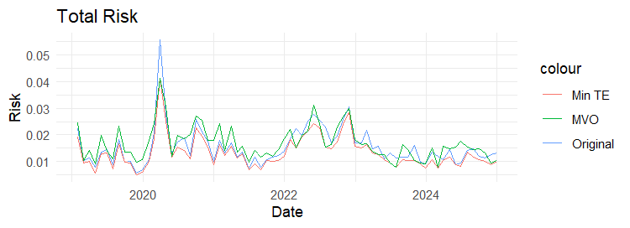
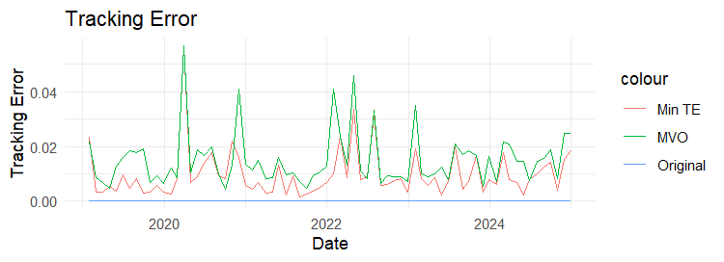
Total Risk and Tracking Error Dynamics
Original: 0.0156
Min TE: 0.0134
MVO: 0.0168
Original: 0 (benchmark)
Min TE: 0.0098
MVO: 0.0151

Slide 14
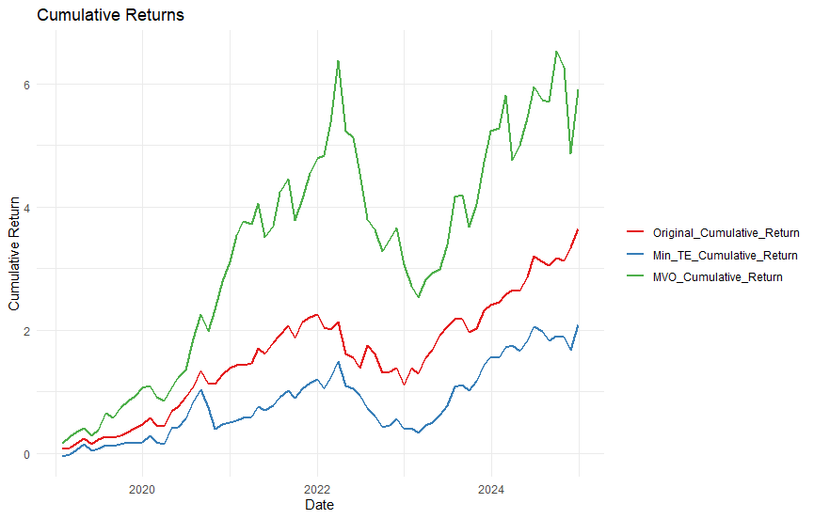
Cumulative Returns
Min TE reduces the overall risk of the investment portfolio and obtains the lowest tracking error. However, due to the pursuit of the minimum tracking error, it ignores the return and increases the weight of high-volatility assets, so the cumulative return is the lowest, but the overall risk is lower.
MVO optimization has the highest cumulative return, but also has the highest risk compared to the other two portfolios. However, for a given return or a given risk, MVO optimization has the lowest risk or the highest return.The goal of MVO is to minimize the variance (risk) of the portfolio and find the optimal portfolio under a given expected return. Such a goal may lead to a portfolio on the efficient frontier with a good trade-off between return and risk

Slide 15
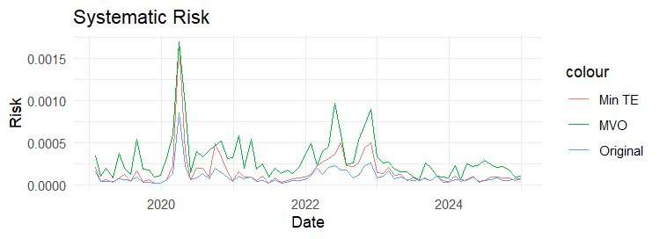
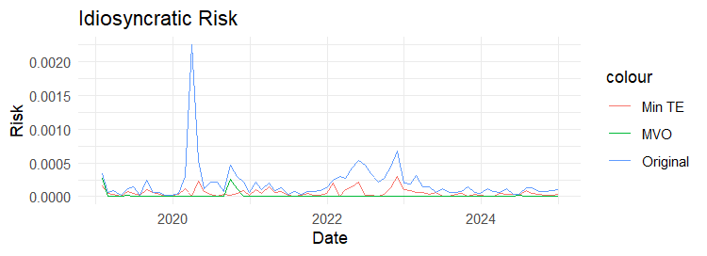
Historical Risk Decomposition
Original: 0.00009889
Min TE: 0.0001583
MVO: 0.0003108
Original: 0.000197
Min TE: 0.00005695
MVO: 0.000009754
Systematic Risk Overview
Risk Trend Evolution
COVID-19 caused a significant surge, impacting momentum factor trends
During the pandemic, systematic risk trends escalated, with individual stock contributions varying over time

Slide 16
Historical Risk Decomposition
Systematic risk of the unoptimized portfolio the lowest:
Diversification: The unoptimized investment portfolio may be more diversified, reducing the impact of specific market factors on the overall performance of the portfolio, thus lowering systematic risk.
Asset Allocation: The original portfolio may naturally lower systematic risk through even allocation or a mix of different assets, while optimized models may concentrate on fewer assets, causing systematic risk to rise.
Idiosyncratic risk lower after optimization:
Diversification Effect: Optimization models (such as Min TE and MVO) typically seek to balance risk and return across all assets, effectively diversifying away specific stock or industry risks.
Optimization Objectives: These strategies aim to minimize idiosyncratic risk by building a more efficient portfolio through better asset allocation while controlling for overall risk.

Slide 17
Part 3: Conclusion and weakness
03

Slide 18
Conclusion
Overall, optimization strategies (such as MVO and Min TE) do not always effectively enhance returns and Sharpe ratios. Their effectiveness is highly dependent on market conditions, asset characteristics, and the objectives of the optimization. Therefore, it is essential to consider current market conditions, asset features, and investment goals thoroughly before implementing optimization.
Optimal Strategies
Min TE: Suitable for risk-averse investors
MVO: Offers high risk-reward ratio for aggressive profiles

Slide 19
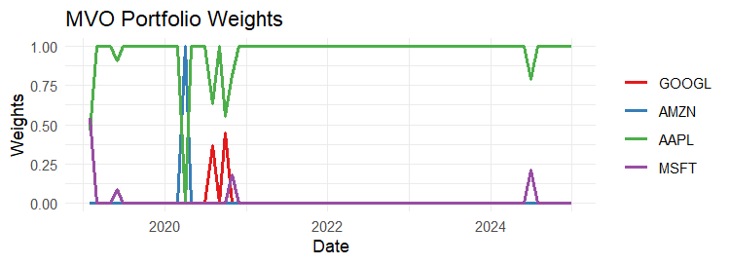
Weakness and improvement
Weakness: MVO has highest returns , but has highest volatility, risk and systematic risk, which may lead to fail to makert.
Reason: Optimazation constrians do not limit weight of each stock, which makes that portofolio foucs on one stock, making portfolio risky.
Improvement: Choose more factors.
In marker strategy, we can short some stock to hedge the risk and make return higer instead of foucsing long-term stock in portfolio.

Slide 20
Thank you!

